Slide 1
UNIT 2 - CSS 3
Introduction
Colors
text formatting
fonts formatting
Background formatting
2D transform
Transition,
animation,
user interface

Slide 2
INTRODUCTION
CSS3 is the latest standard for CSS.
CSS3 is completely backwards-compatible with earlier versions of CSS.
Cascading Style Sheets (CSS) is a style sheet language used for describing the look and formatting of a document written in a markup language.

Slide 3
CSS3 modules
CSS3 has been split into "modules". It contains the "old CSS specification" (which has been split into smaller pieces). In addition, new modules are added.
Some of the most important CSS3 modules are:
Selectors
Box Model
Backgrounds and Borders
Image Values and Replaced Content
Text Effects
2D/3D Transformations
Animations
Multiple Column Layout
User Interface
Most of the new CSS3 properties are implemented in modern browsers.

Slide 4
COLORS

Slide 5
Colors
CSS supports color names, hexadecimal and RGB colors.
In addition, CSS3 also introduces:
a) RGBA colors
b) HSL colors
c) HSLA colors
d) opacity

Slide 6
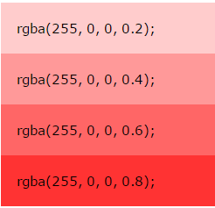
a) RGBA
RGBA color values are an extension of RGB color values with an alpha channel - which specifies the opacity for a color.
An RGBA color value is specified with: rgba(red, green, blue, alpha). The alpha parameter is a number between 0.0 (fully transparent) and 1.0 (fully opaque).
#p1 {background-color: rgba(255, 0, 0, 0.3);} /* red with opacity */ #p2 {background-color: rgba(0, 255, 0, 0.3);} /* green with opacity */ #p3 {background-color: rgba(0, 0, 255, 0.3);} /* blue with opacity */

Slide 7
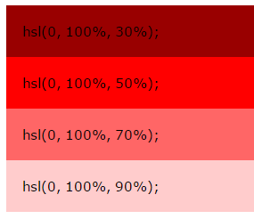
b) HSL Colors
HSL stands for Hue, Saturation and Lightness.
An HSL color value is specified with: hsl(hue, saturation, lightness).
Hue is a degree on the color wheel (from 0 to 360):
0 (or 360) is red
120 is green
240 is blue
Saturation is a percentage value: 100% is the full color.
Lightness is also a percentage; 0% is dark (black) and 100% is white.

Slide 8
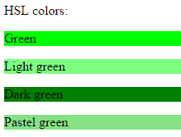
Example:
#p1 {background-color: hsl(120, 100%, 50%);} /* green */ #p2 {background-color: hsl(120, 100%, 75%);} /* light green */ #p3 {background-color: hsl(120, 100%, 25%);} /* dark green */ #p4 {background-color: hsl(120, 60%, 70%);} /* pastel green */

Slide 9
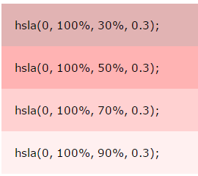
c) HSLA Colors
HSLA color values are an extension of HSL color values with an alpha channel - which specifies the opacity for a color.
An HSLA color value is specified with: hsla(hue, saturation, lightness, alpha), where the alpha parameter defines the opacity. The alpha parameter is a number between 0.0 (fully transparent) and 1.0 (fully opaque).

Slide 10
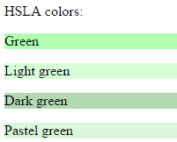
Example
#p1 {background-color: hsla(120, 100%, 50%, 0.3);} /* green with opacity */
#p2 {background-color: hsla(120, 100%, 75%, 0.3);} /*light green with opacity */
#p3 {background-color: hsla(120, 100%, 25%, 0.3);} /*dark green with opacity */
#p4 {background-color: hsla(120, 60%, 70%, 0.3);} /*pastel green with opacity */

Slide 11
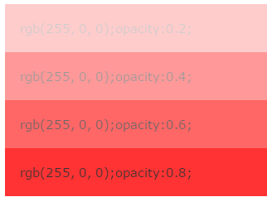
Opacity
The CSS3 opacity property sets the opacity for the whole element (both background color and text will be opaque/transparent).
The opacity property value must be a number between 0.0 (fully transparent) and 1.0 (fully opaque).
Notice that the text above will also be transparent/opaque!

Slide 12
TEXT FORMATTING

Slide 13
CSS3 contains several new text features.
Newly added text properties:
text-overflow
word-wrap
word-break

Slide 14
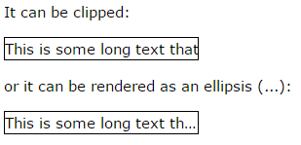
a) Text overflow
The CSS3 text-overflow property specifies how overflowed content that is not displayed should be signaled to the user.

Slide 15
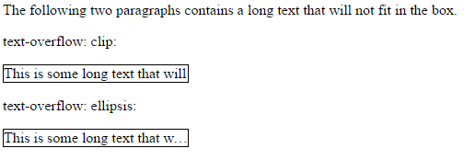
<!DOCTYPE html>
<html> <head> <style>
p.test1 { white-space: nowrap;
width: 200px;
border: 1px solid #000000;
overflow:hidden;
text-overflow: clip;
}
p.test2 { white-space: nowrap;
width: 200px;
border: 1px solid #000000;
overflow: hidden;
text-overflow: ellipsis;
}
</style> </head>
<body>
<p>The following two paragraphs contains a long text that will not fit in the box.</p>
<p>text-overflow: clip:</p>
<p class="test1">This is some long text that will not fit in the box</p>
<p>text-overflow: ellipsis:</p>
<p class="test2">This is some long text that will not fit in the box</p>
</body> </html>
OUTPUT

Slide 16
The following example shows how you can display the overflowed content when hovering over the element:
div.test:hover { text-overflow: inherit; overflow: visible; }

Slide 17
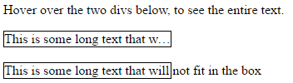
Example: Hover
<!DOCTYPE html>
<html> <head> <style>
div.test { white-space: nowrap;
width: 200px;
overflow: hidden;
border: 1px solid #000000;
}
div.test:hover { text-overflow: inherit;
overflow: visible;
}
</style> </head>
<body>
<p>Hover over the two divs below, to see the entire text.</p>
<div class="test" style="text-overflow:ellipsis;">This is some long text that will not fit in the box</div><br>
<div class="test" style="text-overflow:clip;">This is some long text that will not fit in the box</div>
</body>
</html>
OUTPUT

Slide 18
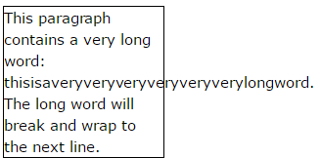
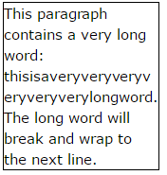
b) Word wrapping
The CSS3 word-wrap property allows long words to be able to be broken and wrap onto the next line.
If a word is too long to fit within an area, it expands outside:
The word-wrap property allows you to force the text to wrap - even if it means splitting it in the middle of a word:

Slide 19
Css code to Allow long words to be able to be broken and wrap onto the next line:
p { word-wrap: break-word; }

Slide 20
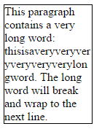
Example: word wrap
<!DOCTYPE html>
<html> <head> <style>
p.test {
width: 120px;
border: 1px solid #000000;
word-wrap: break-word;
}
</style> </head>
<body>
<p class="test"> This paragraph contains a very long word: thisisaveryveryveryveryveryverylongword. The long word will break and wrap to the next line.</p>
</body> </html>
OUTPUT

Slide 21
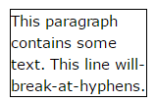
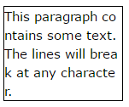
c) Word breaking
The CSS3 word-break property specifies line breaking rules.
CSS CODE for word break
p.test1 { word-break: keep-all; } p.test2 { word-break: break-all; }

Slide 22
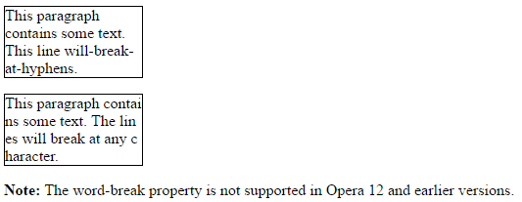
Example: word break
<!DOCTYPE html>
<html> <head> <style>
p.test1 {
width: 140px;
border: 1px solid #000000;
word-break: keep-all;
}
p.test2 {
width: 140px;
border: 1px solid #000000;
word-break: break-all;
}
</style> </head>
<body>
<p class="test1">This paragraph contains some text. This line will-break-at-hyphens.</p>
<p class="test2">This paragraph contains some text. The lines will break at any character.</p>
</body>
</html>
OUTPUT

Slide 23
Background

Slide 24
CSS3 contains a few new background properties, which allow greater control of the background element.
With css3, we can add multiple background images to one element.
We will also learn about the following new CSS3 properties:
a) background-size
b) background-origin
c) background-clip

Slide 25
Css3 multiple backgrounds- (background –image property)
CSS3 allows you to add multiple background images for an element, through the background-image property.
The different background images are separated by commas, and the images are stacked on top of each other, where the first image is closest to the viewer.
#example1 { background-image: url(img_flwr.gif), url(paper.gif); background-position: right bottom, left top; background-repeat: no-repeat, repeat; }
Multiple background can be specified in shorthand
#example1 { background: url(img_flwr.gif) right bottom no-repeat, url(paper.gif) left top repeat; }

Slide 26
Css3 background size- (background –size property)
The CSS3 background-size property allows you to specify the size of background images.
Before CSS3, the size of a background image was the actual size of the image. CSS3 allows us to re-use background images in different contexts.
The size can be specified in lengths, percentages, or by using one of the two keywords: contain or cover.
The following example resizes a background image to much smaller than the original image (using pixels):
#div1 { background: url(img_flower.jpg); background-size: 100px 80px; background-repeat: no-repeat; }

Slide 27
The two other possible values for background-size are contain and cover.
The contain keyword scales the background image to be as large as possible (but both its width and its height must fit inside the content area). As such, depending on the proportions of the background image and the background positioning area, there may be some areas of the background which are not covered by the background image.
The cover keyword scales the background image so that the content area is completely covered by the background image (both its width and height are equal to or exceed the content area). As such, some parts of the background image may not be visible in the background positioning area.
#div1 { background: url(img_flower.jpg); background-size: contain; background-repeat: no-repeat; } #div2 { background: url(img_flower.jpg); background-size: cover; background-repeat: no-repeat; }

Slide 28
Different sizes of multiple background images
the background-size property also accepts multiple values for background size (using a comma-separated list), when working with multiple backgrounds.
The following example has three background images specified, with different background-size value for each image:
#example1 { background: url(img_flwr.gif) left top no-repeat, url(img_flwr.gif) right bottom no-repeat, url(paper.gif) left bottom repeat;
background-size: 50px, 130px, auto; }

Slide 29
Full size background image
Now we want to have a background image on a website that covers the entire browser window at all times.
The requirements are as follows:
a) Fill the entire page with the image (no white space)
b) Scale image as needed
c) Center image on page
d) Do not cause scrollbars
html { background: url(img_flower.jpg) no-repeat center fixed; background-size: cover; }

Slide 30
CSS3 background-origin Property
The CSS3 background-origin property specifies where the background image is positioned.
The property takes three different values:
border-box - the background image starts from the upper left corner of the border
b) padding-box - (default) the background image starts from the upper left corner of the padding edge
c) content-box - the background image starts from the upper left corner of the content

Slide 31
The following example illustrates the background -origin property:
#example1 { border: 10px solid black; padding: 35px; background: url(img_flwr.gif); background-repeat: no-repeat; background-origin: content-box; }

Slide 32
Background-clip property
The CSS3 background-clip property specifies the painting area of the background.
The property takes three different values:
a) border-box - (default) the background is painted to the outside edge of the border
b) padding-box - the background is painted to the outside edge of the padding
c) content-box - the background is painted within the content box
The following example illustrates the background-clip property:
#example1 { border: 10px dotted black; padding: 35px; background: yellow; background-clip: content-box; }

Slide 33
<!DOCTYPE html>
<html><head><style>
#example1 { border: 10px dotted black;
padding: 15px;
background: lightblue;
background-clip: border-box; }
#example2 { border: 10px dotted black;
padding: 15px;
background: lightblue;
background-clip: padding-box;}
#example3 { border: 10px dotted black;
padding: 15px;
background: lightblue;
background-clip: content-box; }</style></head><body>
<h1>The background-clip Property</h1>
<p>The background-clip property defines how far the background should extend within an element.</p>
<p>background-clip: border-box (this is default):</p>
<div id="example1">
<p>The background extends behind the border.</p>
</div>
<p>background-clip: padding-box:</p>
<div id="example2">
<p>The background extends to the inside edge of the border.</p>
</div>
<p>background-clip: content-box:</p>
<div id="example3">
<p>The background extends to the edge of the content box.</p>
</div>
<p><strong>Note:</strong> The background-clip property is not supported in Internet Explorer 8 and earlier versions.</p>
</body>
</html>

Slide 34
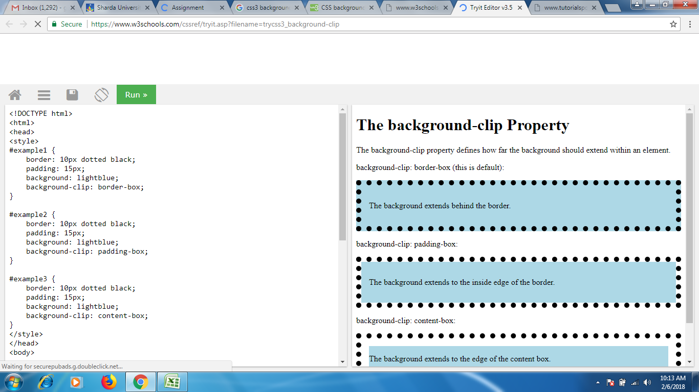

Slide 35
2D Transform

Slide 36
CSS3 Transforms
CSS3 transforms allow you to translate, rotate, scale, and skew elements.
A transformation is an effect that lets an element change shape, size and position.
CSS3 supports 2D and 3D transformations.
2D transformation methods:
translate()
rotate()
scale()
skewX()
skewY()
matrix()

Slide 37
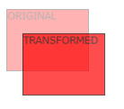
Translate()
The translate() method moves an element from its current position (according to the parameters given for the X-axis and the Y-axis).
The following example moves the <div> element 50 pixels to the right, and 100 pixels down from its current position:
div { transform: translate(50px,100px); }

Slide 38

Rotate()
The rotate() method rotates an element clockwise or counter-clockwise according to a given degree.
The following example rotates the <div> element clockwise with 20 degrees:
div { transform: rotate(20deg); }
Using negative values will rotate the element counter-clockwise.
The following example rotates the <div> element counter-clockwise with 20 degrees:
div { transform: rotate(-20deg); }

Slide 39
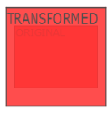
Scale()
The scale() method increases or decreases the size of an element (according to the parameters given for the width and height).
The following example increases the <div> element to be two times of its original width, and three times of its original height:
div { transform: scale(2, 3); }
The following example decreases the <div> element to be half of its original width and height:
div { transform: scale(0.5, 0.5); }

Slide 40
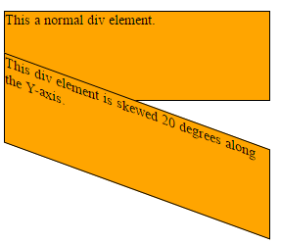
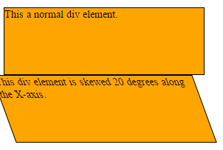
skewX()
The skewX() method skews an element along the X-axis by the given angle.
The following example skews the <div> element 20 degrees along the X-axis:
div { transform: skewX(20deg); }
skewY()
The skewY() method skews an element along the Y-axis by the given angle.
The following example skews the <div> element 20 degrees along the Y-axis:
div { transform: skewY(20deg); }

Slide 41
<!DOCTYPE html>
<html> <head> <style>
div { width: 300px;
height: 100px;
background-color: green;
border: 1px solid black;
}
div#myDiv {
-ms-transform: skewX(20deg); /* IE 9 */
-webkit-transform: skewX(20deg); /* Safari */
transform: skewX(20deg); /* Standard syntax */
}
</style> </head>
<body>
<p>The skewX() method skews an element along the X-axis
by the given angle.</p>
<div>
This a normal div element.
</div>
<div id="myDiv"> This div element is skewed 20 degrees along the X-axis.
</div>
</body> </html>

Slide 42
Skew()
The skew() method skews an element along the X and Y-axis by the given angles.
The following example skews the <div> element 20 degrees along the X-axis, and 10 degrees along the Y-axis:
div { transform: skew(20deg, 10deg); }

Slide 43
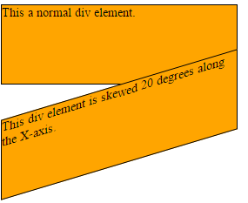
Matrix()
The matrix() method combines all the 2D transform methods into one.
The matrix() method take six parameters, containing mathematic functions, which allows you to rotate, scale, move (translate), and skew elements.
The parameters are as follow:
matrix(scaleX(),skewY(),skewX(),scaleY(),translateX(),translateY()):
div { transform: matrix(1, -0.3, 0, 1, 0, 0); }

Slide 44
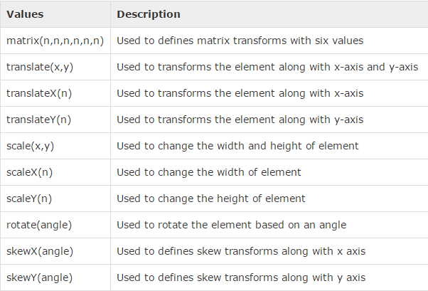

Slide 45
CSS3 Animation

Slide 46
CSS3 animations allows animation of most HTML elements without using JavaScript or Flash!
What are CSS3 Animations?
An animation lets an element gradually change from one style to another.
You can change as many CSS properties you want, as many times you want.
To use CSS3 animation, you must first specify some keyframes for the animation.
Keyframes hold what styles the element will have at certain times.

Slide 47
The @keyframes Rule
When you specify CSS styles inside the @keyframes rule, the animation will gradually change from the current style to the new style at certain times.
To get an animation to work, you must bind the animation to an element.
If the animation-duration property is not specified, the animation will have no effect, because the default value is 0.

Slide 48
The following example binds the "example" animation to the <div> element.
The animation will last for 4 seconds, and it will gradually change the background-color of the <div> element from "red" to "yellow":
/* The animation code */ @keyframes example { from {background-color: red;} to {background-color: yellow;} }
/* The element to apply the animation to */ div { width: 100px; height: 100px; background-color: red; animation-name: example; animation-duration: 4s; }
In the example above we have specified when the style will change by using the keywords "from" and "to" (which represents 0% (start) and 100% (complete)).

Slide 49
The following example will change the background-color of the <div> element when the animation is 25% complete, 50% complete, and again when the animation is 100% complete:
/* The animation code */ @keyframes example { 0% {background-color:red; left:0px; top:0px;} 25% {background-color:yellow; left:200px; top:0px;} 50% {background-color:blue; left:200px; top:200px;} 75% {background-color:green; left:0px; top:200px;} 100% {background-color:red; left:0px; top:0px;} }
/* The element to apply the animation to */ div { width: 100px; height: 100px; position: relative; background-color: red; animation-name: example; animation-duration: 4s; }

Slide 50
Example: changing backgroung color
<!DOCTYPE html> <html> <head>
<style>
div { width: 100px;
height: 100px;
background-color: red;
animation-name: example;
animation-duration: 4s; }
@keyframes example { 0% {background-color: red;}
25% {background-color: yellow;}
50% {background-color: blue;}
100% {background-color: green;} }
</style>
</head> <body>
<div></div>
</body> </html>

Slide 51
Example changing backgroung color and position
<!DOCTYPE html> <html> <head> <style>
div { width: 100px;
height: 100px;
background-color: red;
position: relative;
animation-name: example;
animation-duration: 4s; }
@keyframes example { 0% {background-color:red; left:0px; top:0px;}
25% {background-color:yellow; left:200px; top:0px;}
50% {background-color:blue; left:200px; top:200px;}
75% {background-color:green; left:0px; top:200px;}
100% {background-color:red; left:0px; top:0px;} }
</style> </head> <body>
<p><b>Note:</b> This example does not work in Internet Explorer 9 and earlier versions.</p>
<div></div>
</body> </html>

Slide 52
Delay in animation
The animation-delay property specifies a delay for the start of an animation.
The following example has a 2 seconds delay before starting the animation:
div { width: 100px; height: 100px; position: relative; background-color: red; animation-name: example; animation-duration: 4s; animation-delay: 2s; }

Slide 53
Set How Many Times an Animation Should Run
The animation-iteration-count property specifies the number of times an animation should run.
The following example will run the animation 3 times before it stops:
div { width: 100px; height: 100px; position: relative; background-color: red; animation-name: example; animation-duration: 4s; animation-iteration-count: 3; }
write value "infinite" to make the animation continue for ever:
animation-iteration-count: infinite

Slide 54
Run Animation in Reverse Direction or Alternate Cycles
animation run in reverse direction
div { width: 100px; height: 100px; position: relative; background-color: red; animation-name: example; animation-duration: 4s; animation-iteration-count: 3; animation-direction: reverse; }
value "alternate" to make the animation first run forward, then backward, then forward:
div { width: 100px; height: 100px; position: relative; background-color: red; animation-name: example; animation-duration: 4s; animation-iteration-count: 3; animation-direction: alternate; }

Slide 55
Specify the Speed Curve of the Animation
The animation-timing-function property specifies the speed curve of the animation.
The animation-timing-function property can have the following values:
ease - specifies an animation with a slow start, then fast, then end slowly (this is default)
linear - specifies an animation with the same speed from start to end
ease-in - specifies an animation with a slow start
ease-out - specifies an animation with a slow end
ease-in-out - specifies an animation with a slow start and end
cubic-bezier(n,n,n,n) - lets you define your own values in a cubic-bezier function
The following example shows the some of the different speed curves that can be used:
#div1 {animation-timing-function: linear;} #div2 {animation-timing-function: ease;}

